Slide 1
Community or Households
The current consensus among those with field experience in rural water and sanitation, is that projects which provide solutions for individual families, are more likely to be well maintained and operate for a longer period than projects which address the larger community.
https://www.rural-water-supply.net/en/resources/details/1066
Notes:
Page 157 in I TRIED TO SAVE THE WORLD AND FAILED By Larry Siegel (2022)

Slide 2
Community scale projects fail
$350 filter provided water for 100 students
No replacement parts included with initial installation
Failed at about 1 year as filters clogged
Notes:
Page 71

Slide 3
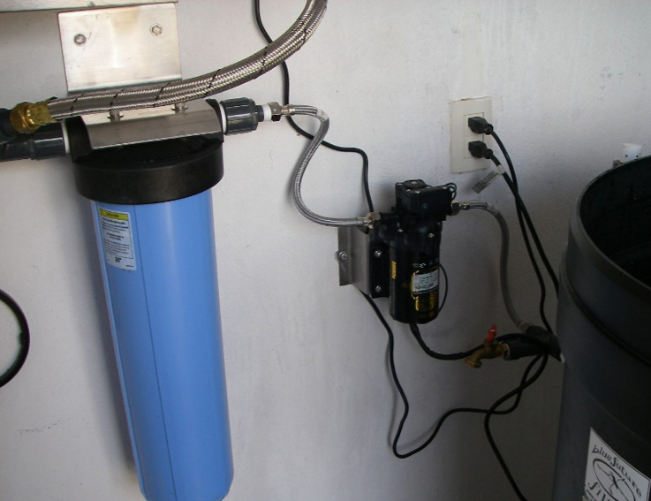
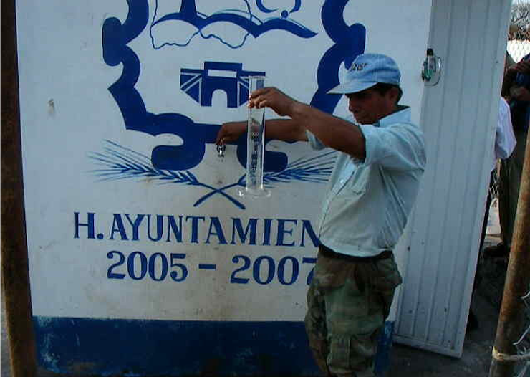
La Cienaga
4 months needed new carbon filter ($60 divided between 12 families)
Community didn’t replace the filter
Notes:
Page 58

Slide 4
Reflections
Why do AguaClara projects succeed where others fail?
Is there magic in the 40 minute failure of AguaClara plants?
AguaClara plants have replaced failed or abandoned
Household sand filters
Multiple stage filtration plants
Rapid sand filtration plants

Slide 5
Community or Households
The current consensus among those with field experience in rural water and sanitation, is that projects which provide solutions for individual families, are more likely to be well maintained and operate for a longer period than projects which address the larger community.
No qualifiers? No scale effect? So each family should have their own cell tower? No pipes needed?
https://www.rural-water-supply.net/en/resources/details/1066
Notes:
Page 157 in I TRIED TO SAVE THE WORLD AND FAILED By Larry Siegel (2022)

